Slide 1


Probabilistic Predictions of Severe Weather with Machine Learning
Aaron J. Hill and Russ S. Schumacher
Colorado State University
Columbia WFO Severe Wx Workshop
Tuesday March 29th 2022

Slide 2
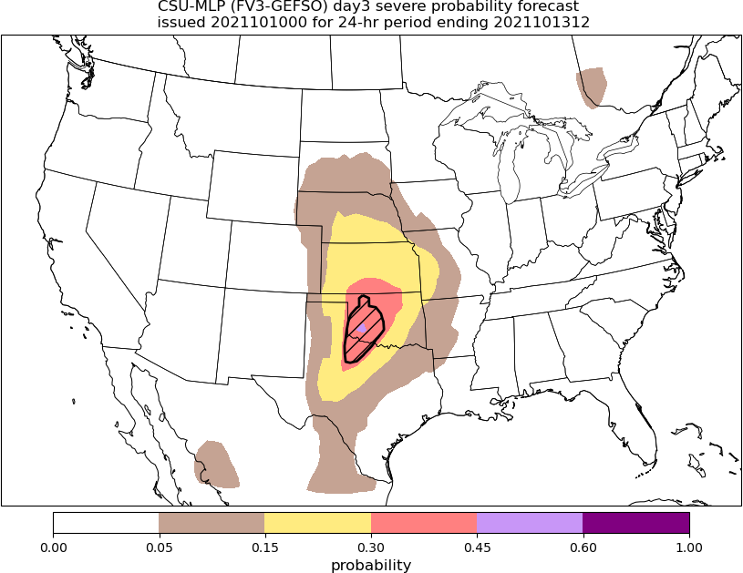
Introduction
ML is becoming more prevalent in weather forecasting as an alternative method to postprocess the numerous and vast datasets that dynamical models produce
As one example, there are ML systems that forecast severe weather by emulating Storm Prediction Center outlooks
HREF (Loken et al. 2020)
HRRR (Sobash et al. 2020)
GEFS (CSU model; Hill et al. 2020)
Notes:
ML is becoming more prevalent in weather forecasting as an alternative means to leverage the numerous and vast datasets that dynamical models produce
As one example, there are now (that we know of) three separate ML systems that forecast severe weather by emulating Storm Prediction Center outlooks
These are based on the HREF, HRRR, and GEFS (loken, Sobash, Hill)

Slide 3
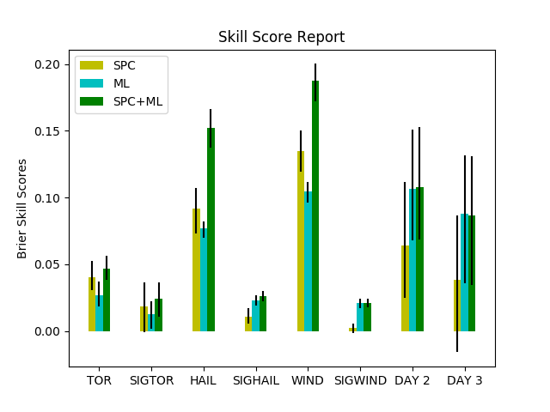
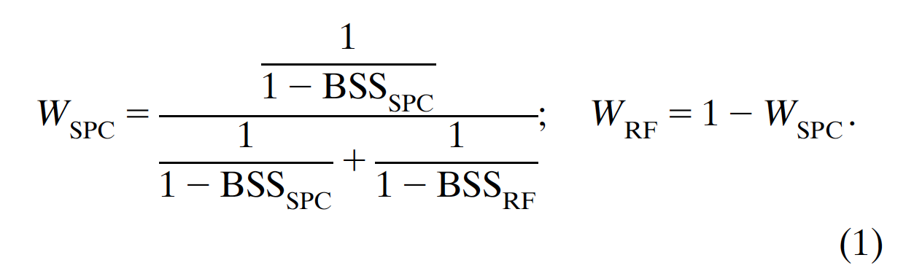
Introduction
Day 1
Day 2
Day 3
One of the reasons these types of systems are being pursued is the operational benefit that might be incurred → first guess fields
Hill et al. (2020): a combination of SPC and random forest (RF)-based outlooks (i.e., blend) often outperformed either individual forecast/outlook
The incorporation of ML-based guidance into the human forecast (via statistical weighting) improved the guidance
Benefit extended beyond day 1
ML forecasts (and the blends) were improved at days 2 and 3 over SPC outlooks
Blend weights:
Hill et al. (2020)
Notes:
One of the reasons these types of systems are being pursued is the operational benefit that might be incurred
In Hill et al. 2020, SPC outlooks and RF-based forecasts of severe weather (individual hazards as well as aggregate hazards) were evaluated against one another.
One important outcome of that work was that a combination of SPC and RF outlooks (i.e., blend) often outperformed either individual component
In other words, the incorporation (in our example a statistical manner) of ML-based guidance was improving upon the human forecasts
One additional outcome, that motivates the rest of this presentation, is the benefit was that was seen beyond day 1
ML forecasts (and the blends) were improved at days 2 and 3 over SPC outlooks

Slide 4
Medium-range Products
CAMs primarily limited to day 3 or earlier
Deterministic global model solutions (GFS, ECMWF, etc.)
Global ensembles (GEFS, ECMWF Ensemble, etc.)
Beyond the SREF (e.g., total severe), there is limited postprocessing at extended ranges
Direct use of ensemble mean doesn’t provide a lot of confidence for severe weather
→ Recent work has focused on extending the CSU RF-based guidance products out to days 4-8

Slide 5
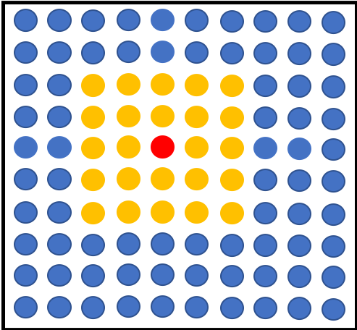
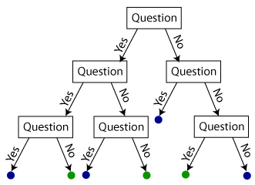
Forecast point
Random Forests
Temperature at (-2, -1) > 20 C?
A set of decision trees that contain a series of yes/no questions based on input predictors that allow traversal of the tree
Relative frequency of events across the forest is the forecast probability
Python Scikit-learn package controls how the decision trees are developed during model training, i.e., what predictor information is used at each branch node to discriminate observed hazards
…..
CAPE at (1, -2) > 500 J/kg?
Probability of severe hail
50%

Slide 6
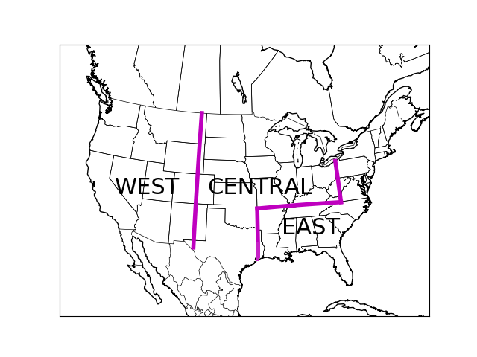
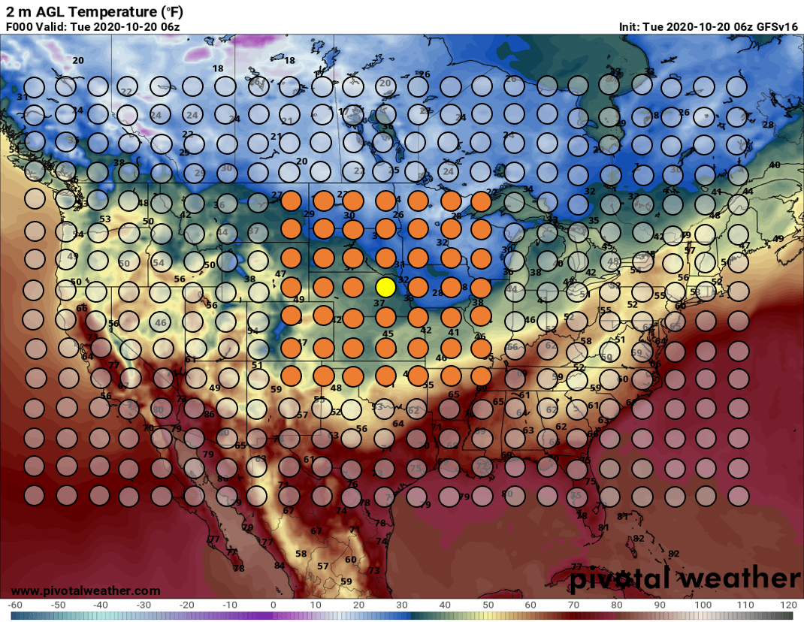
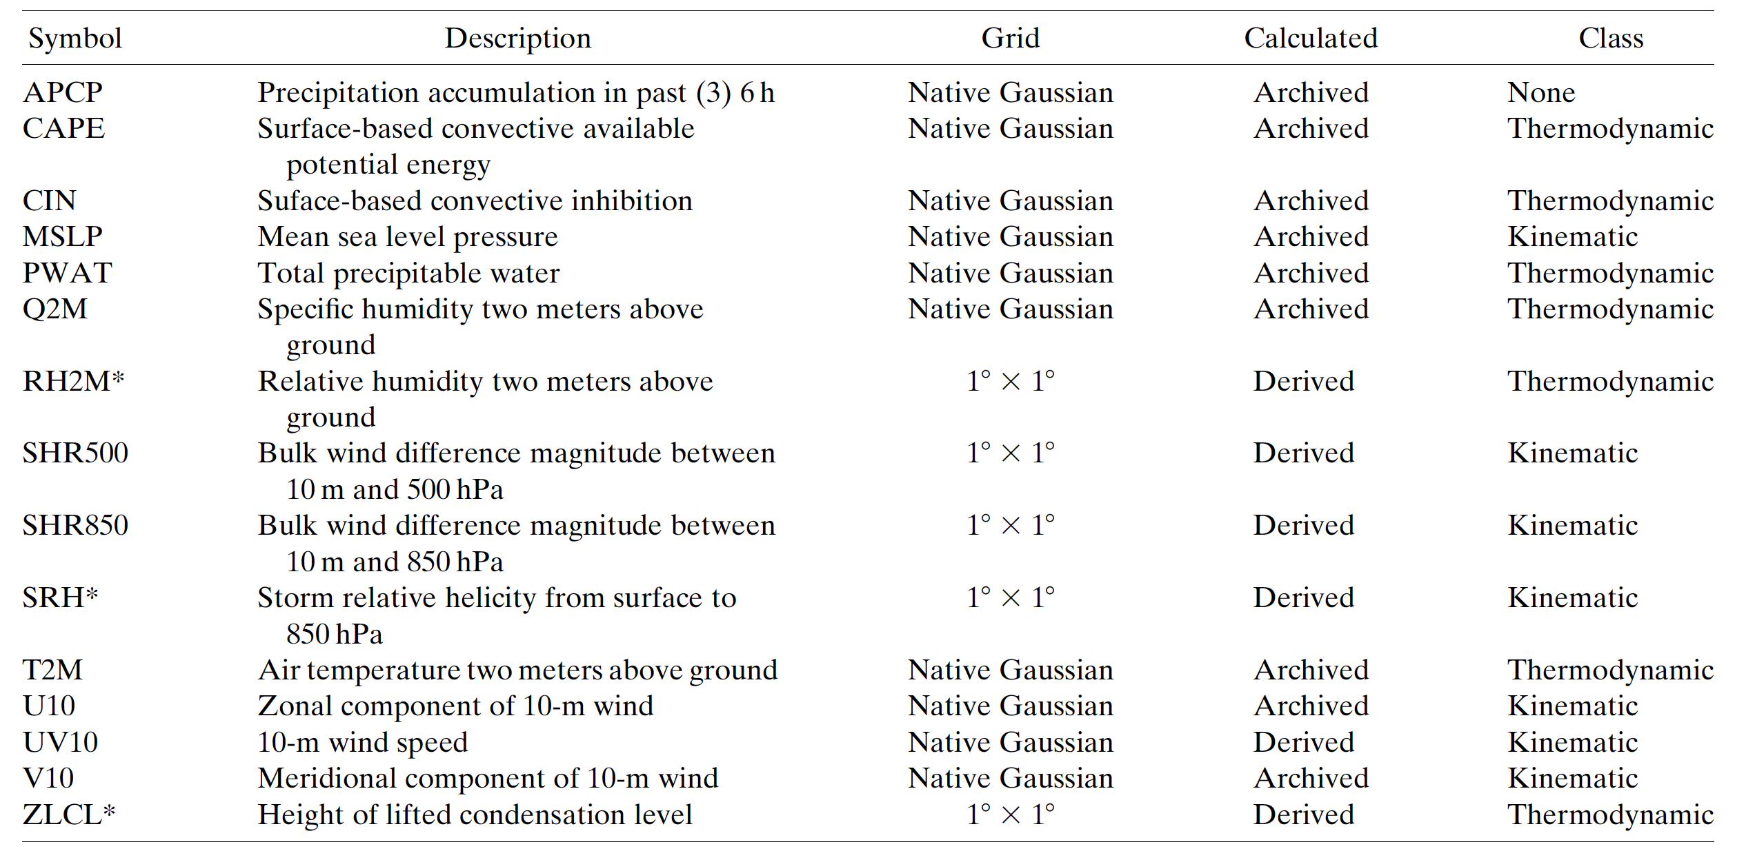
RF Model Setup
Local storm reports (Storm Data) define severe weather events
Inputs: FV3-GEFS/Reforecast ensemble median
2003-2012
Daily 00Z initializations with 5 members
3-hourly temporal frequency over the 24-hour forecast periods (i.e., 1200-1200 UTC) defining days 4-8
Day 4 (forecast hours 84-108), Day 5 (hours 108-132), etc…
Forecast-point relative framework with a predictor radius
Captures any spatiotemporal model biases
Combination of raw fields and derived quantities (e.g., shear)
Currently, each regional model uses the same set of predictors
5300 predictors per example/forecast point

Slide 7
Training Procedure
April 2003 – April 2012
Variables
APCP
CAPE
CIN
MSLP
PWAT
Q2
T2M
0-500 Shear
0-850 Shear
U10
V10
UV10
Days of Training
FV3-GEFS/R gridded dataset
…………
TOR, WIND, or HAIL gridded local storm report (LSR)
Temporal Frequency
(e.g., 3 hrly)
Real-time model output
MODEL
Spatial frequency (5 grid points)

Slide 8
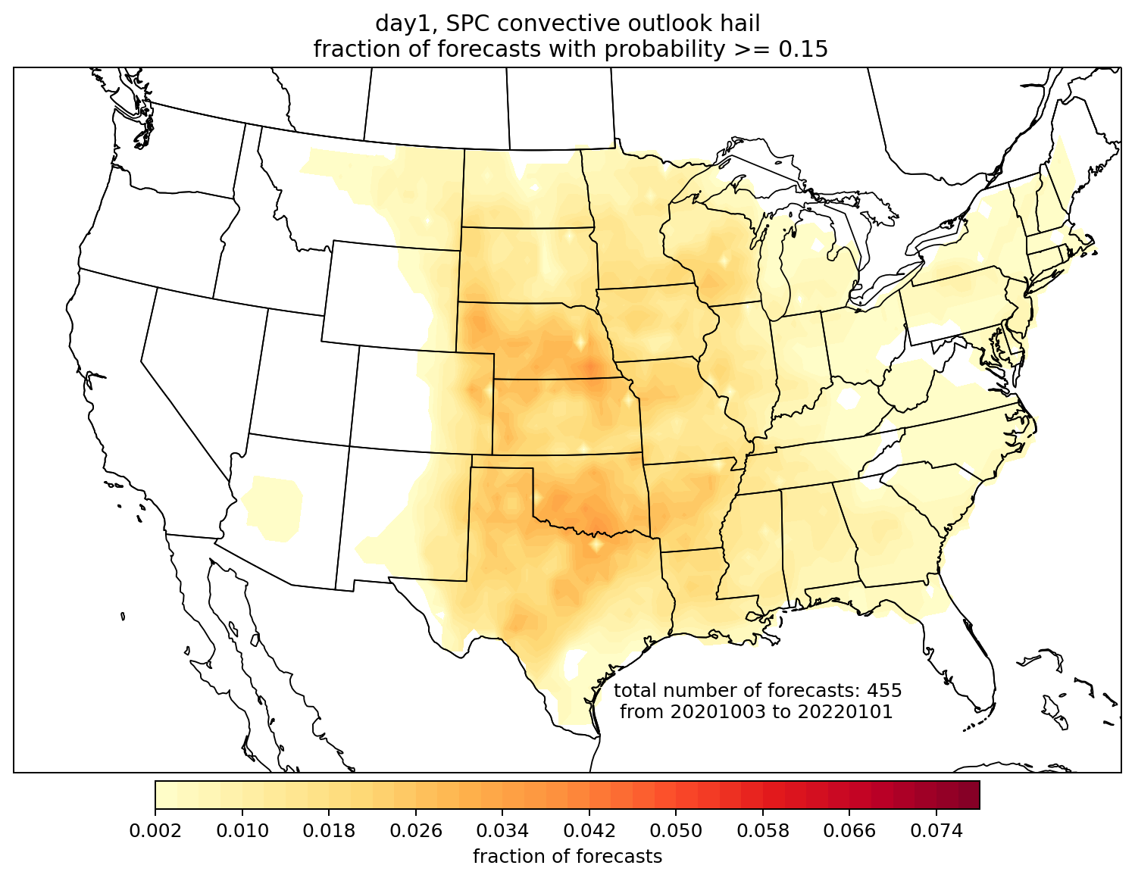
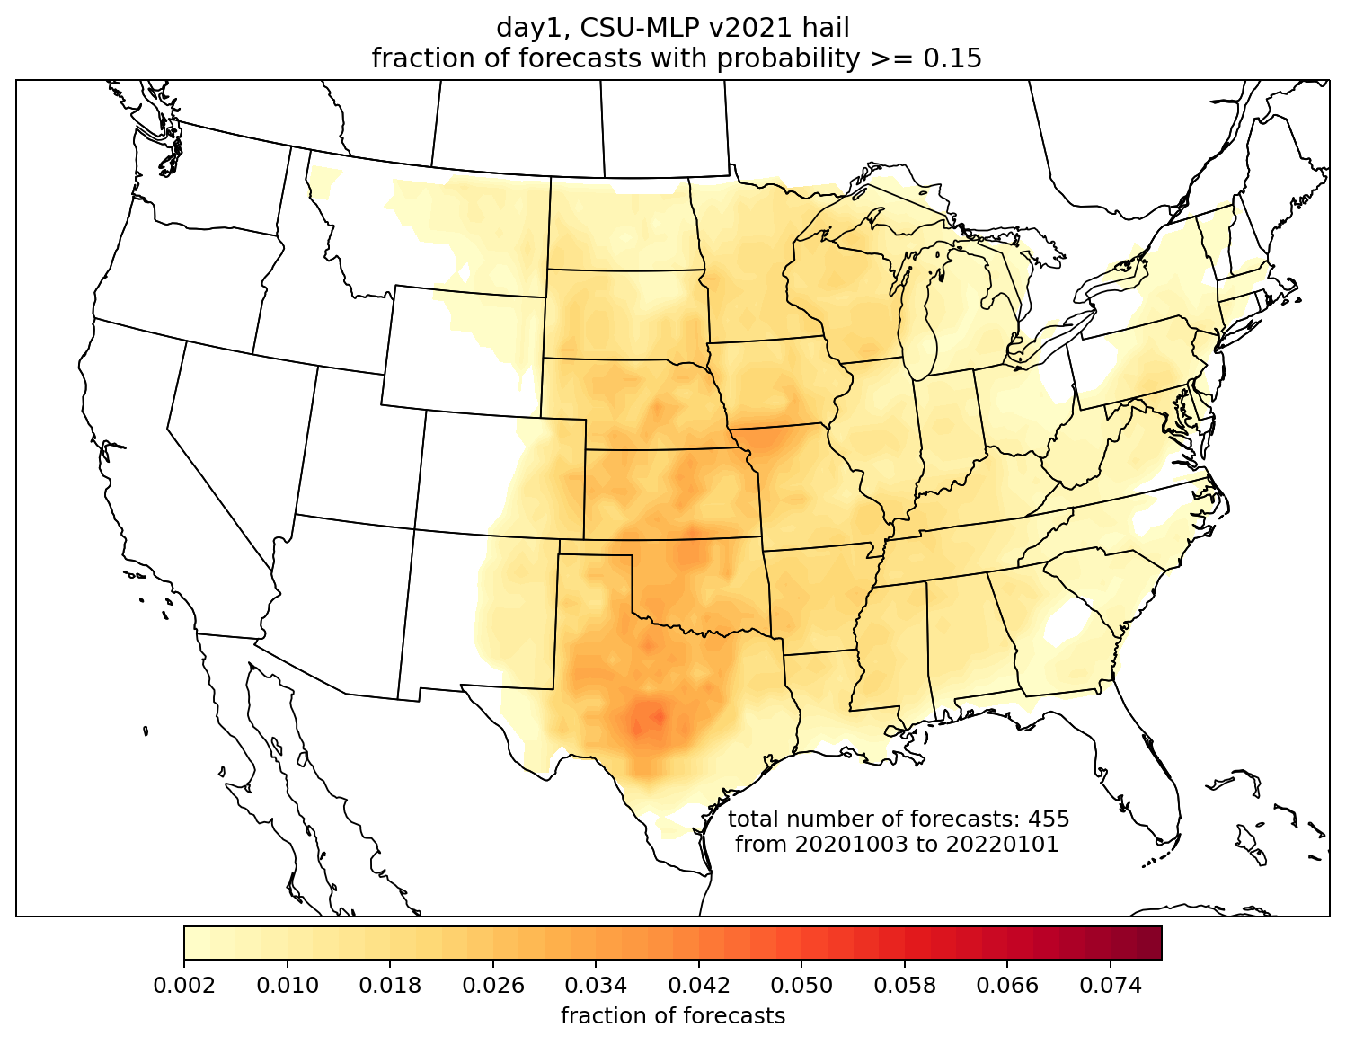
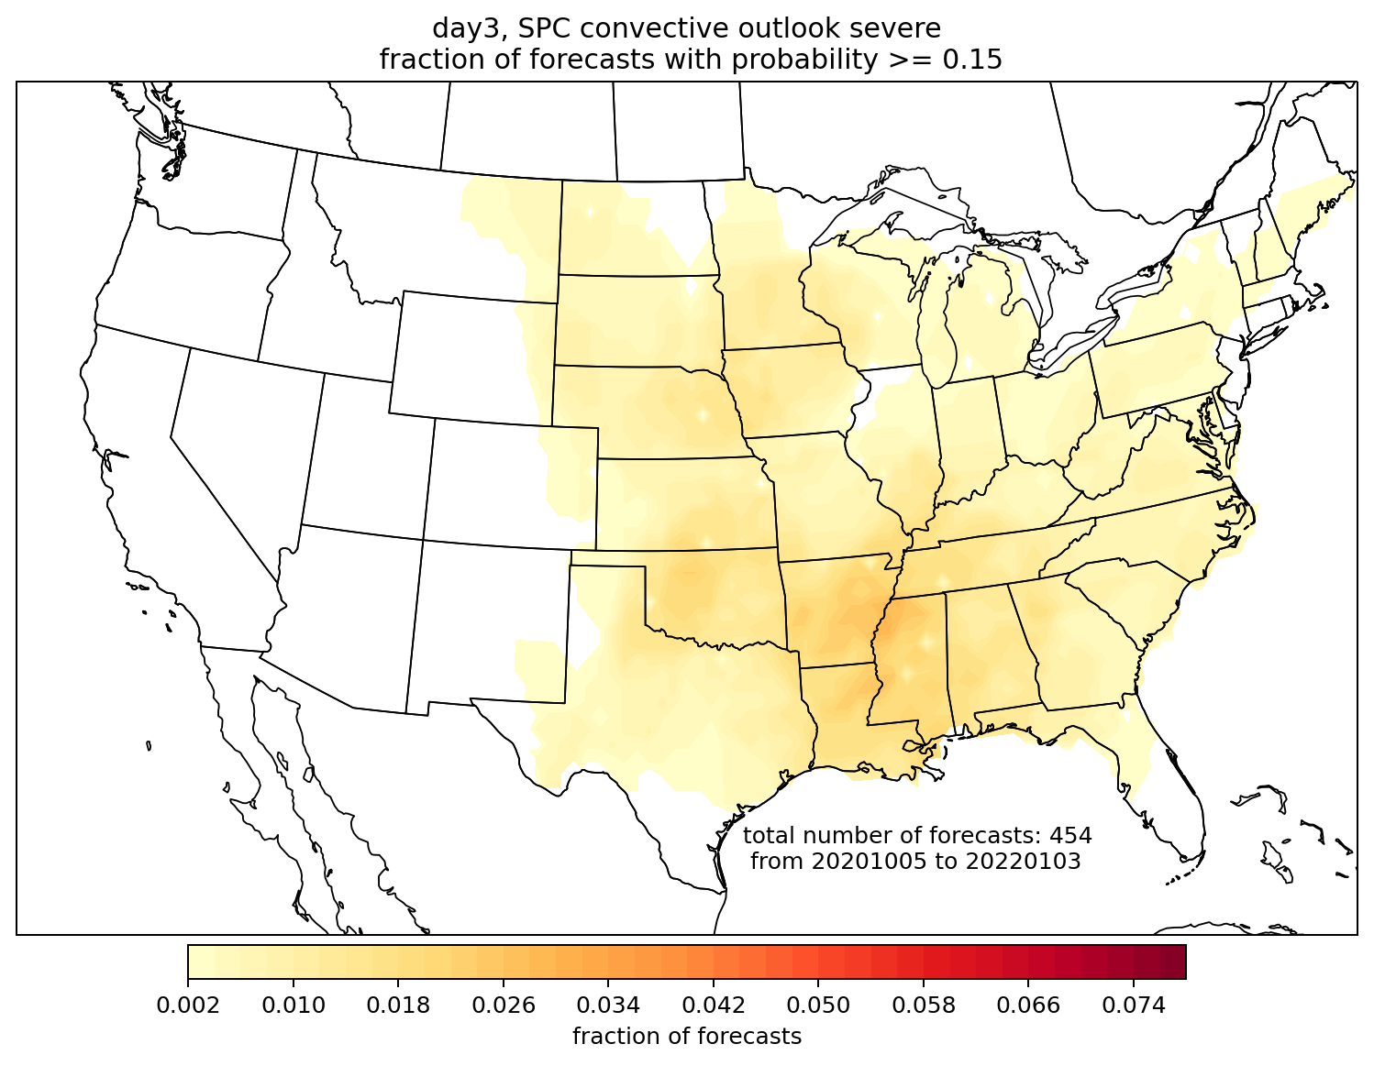
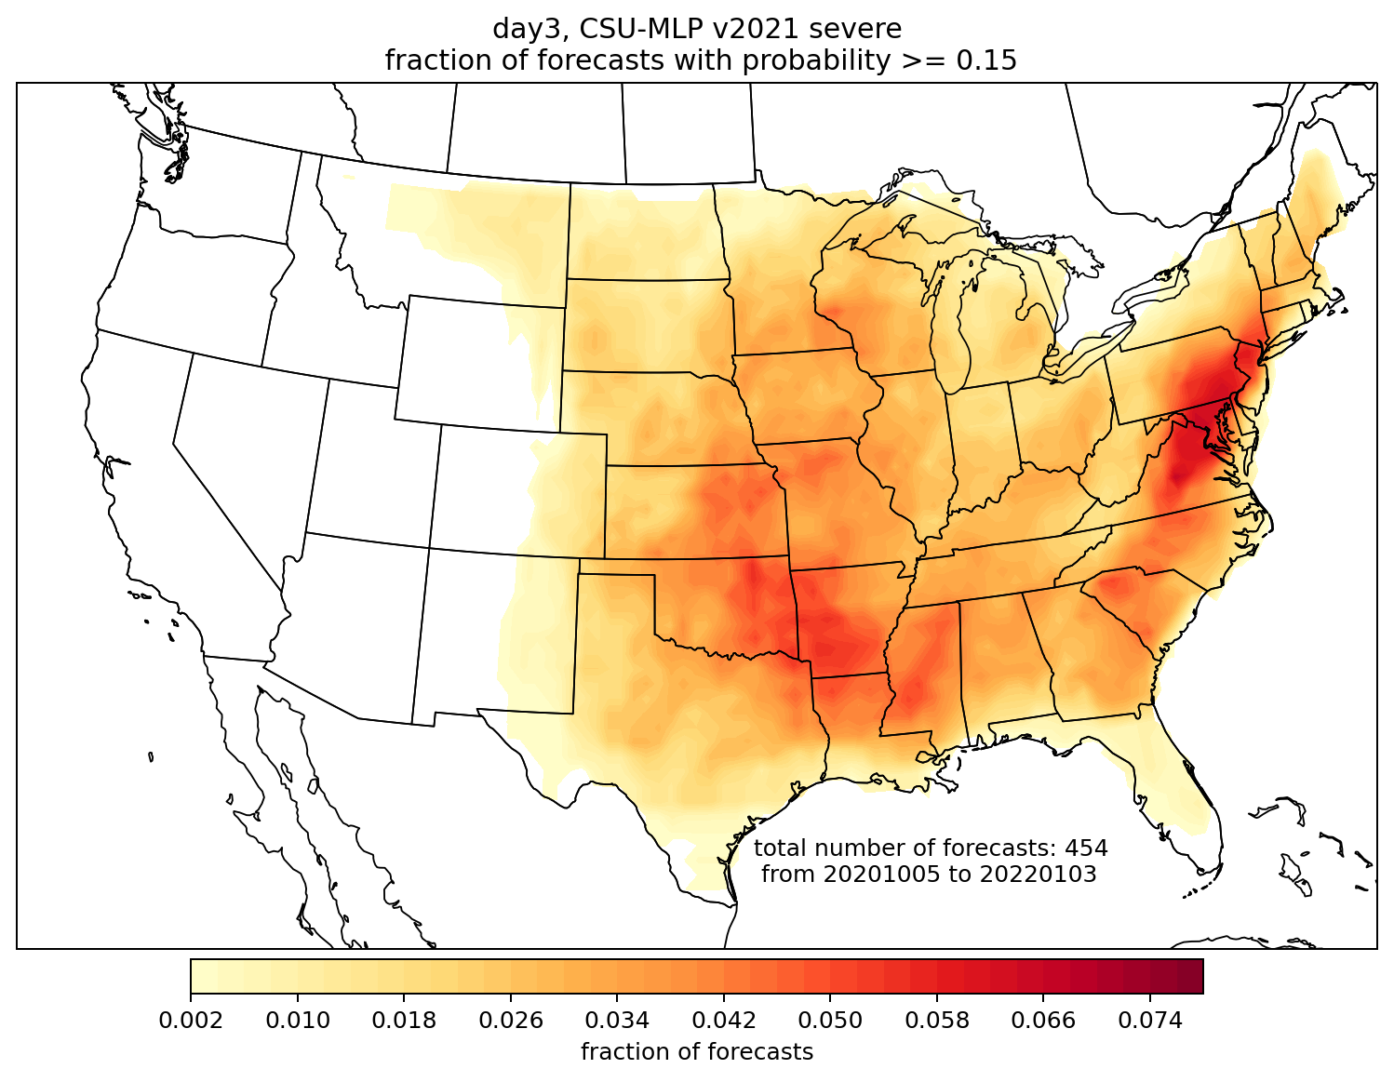
CSU-MLP forecast probabilities are issued at similar frequency to SPC on day 1; much more frequently on day 3
Day 1 hail, 15%
SPC
CSU-MLP
Day 3,
all severe, 15%
SPC
CSU-MLP

Slide 9
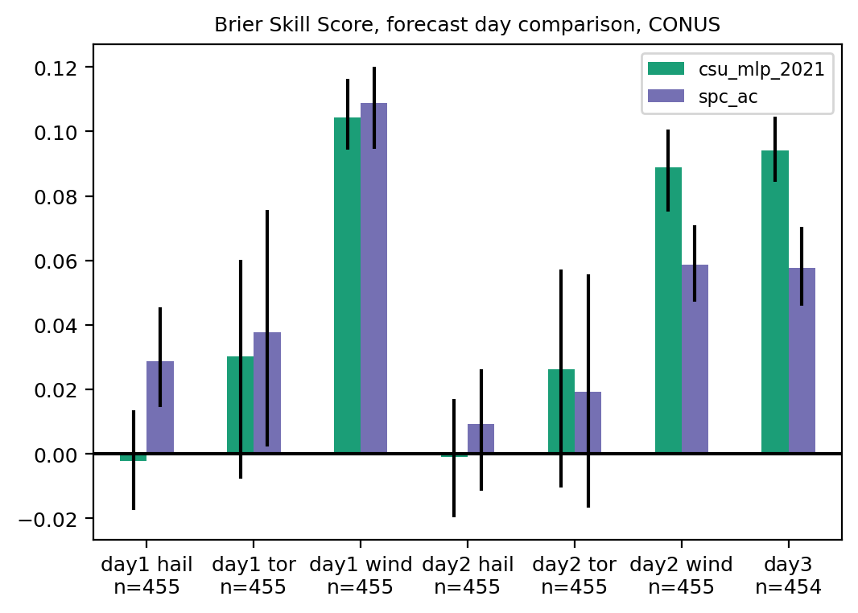
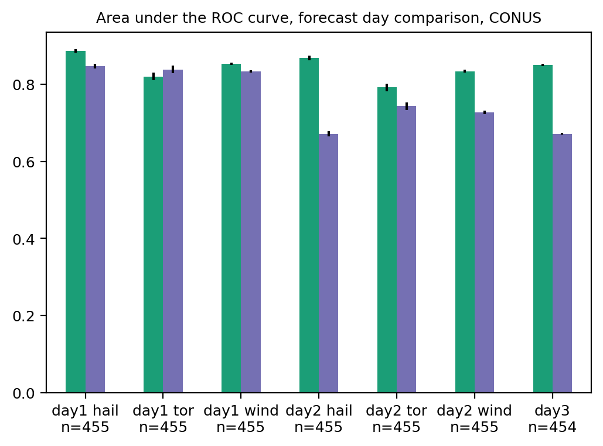
Brier skill score and ROC area, by day and hazard
Tough to beat SPC’s expertise on day 1: they show higher BSS for all hazards, though ROC area is more comparable
Both SPC and CSU-MLP were most skillful for wind, least for hail
CSU-MLP was more skillful for day 2 wind and day 3; high ROC areas suggest potential for further improvement with better calibration

Slide 10
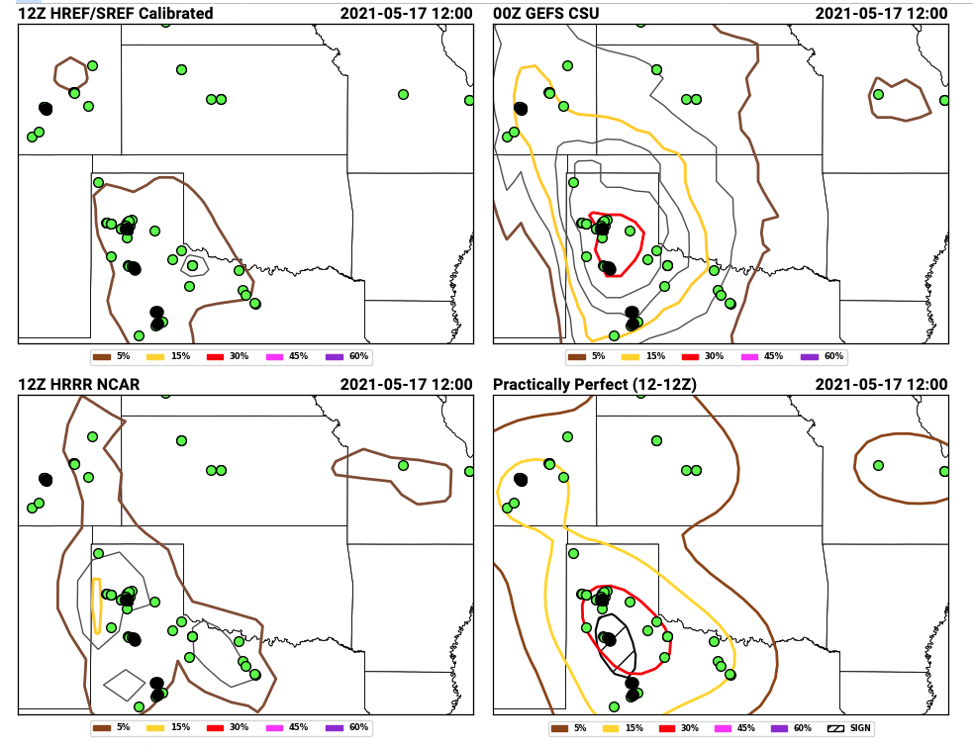
These forecasts were demonstrated and evaluated during the Hazardous Weather Testbed Spring Forecasting Experiment
Day-2 hail forecasts issued 15 May 2021, valid 16-17 May 2021
Day-2 hail forecasts issued 15 May 2021, valid 16-17 May 2021
https://hwt.nssl.noaa.gov/sfe_viewer/2021/outlook_verification/

Slide 11
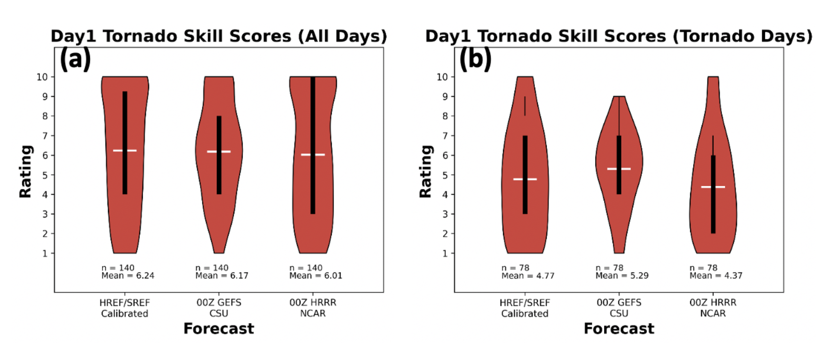
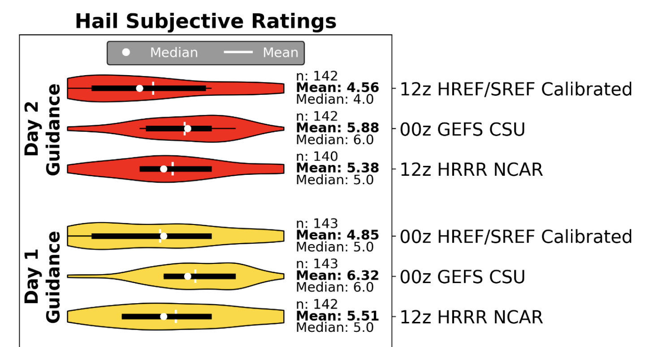
Subjective evaluations by participants (1-10 scale)
“For the set of tornadic days [for day 1 guidance], GEFS CSU performs the best with a mean skill score of 5.39 as compared to the other two methods, which have mean score values less than 4.8.”
[For day 1 hail guidance], “GEFS CSU received the greatest mean participant rating (6.32), followed by HRRR NCAR (5.51) and HREF/SREF (4.85; yellow violins in Fig. 6).”
https://hwt.nssl.noaa.gov/sfe/2021/docs/HWT_SFE_2021_Prelim_Findings_FINAL.pdf

Slide 12
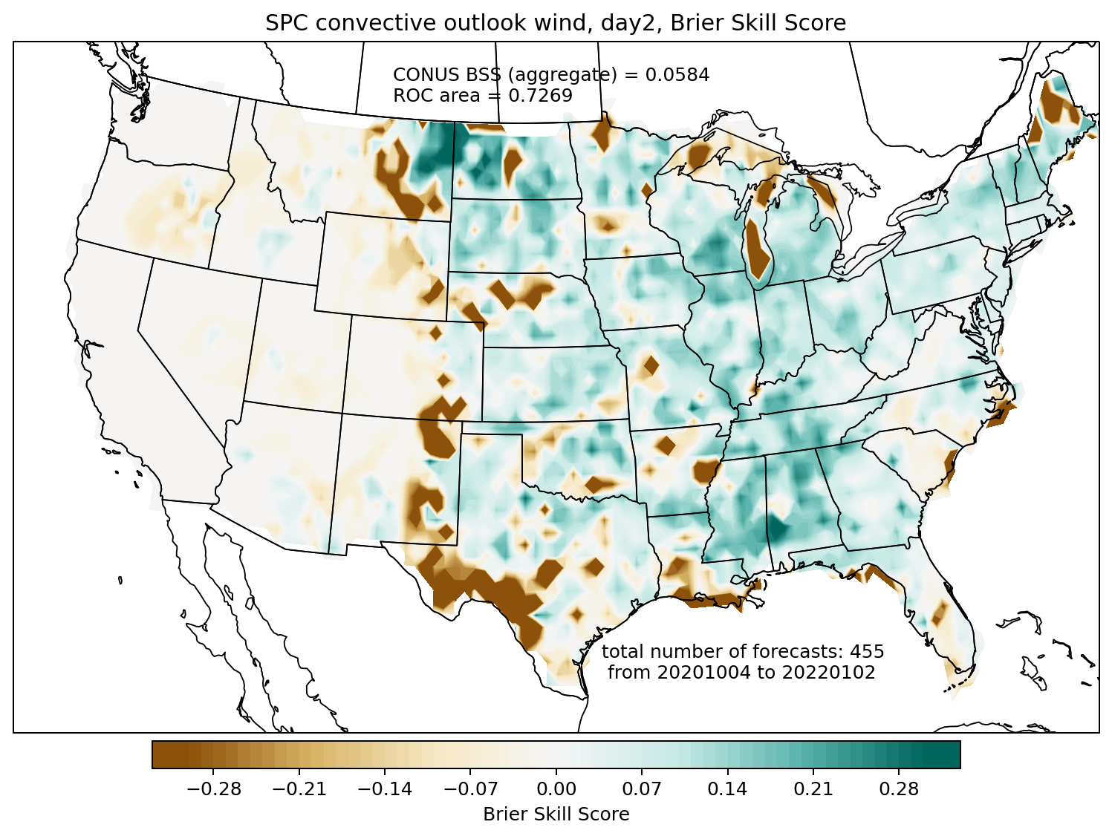
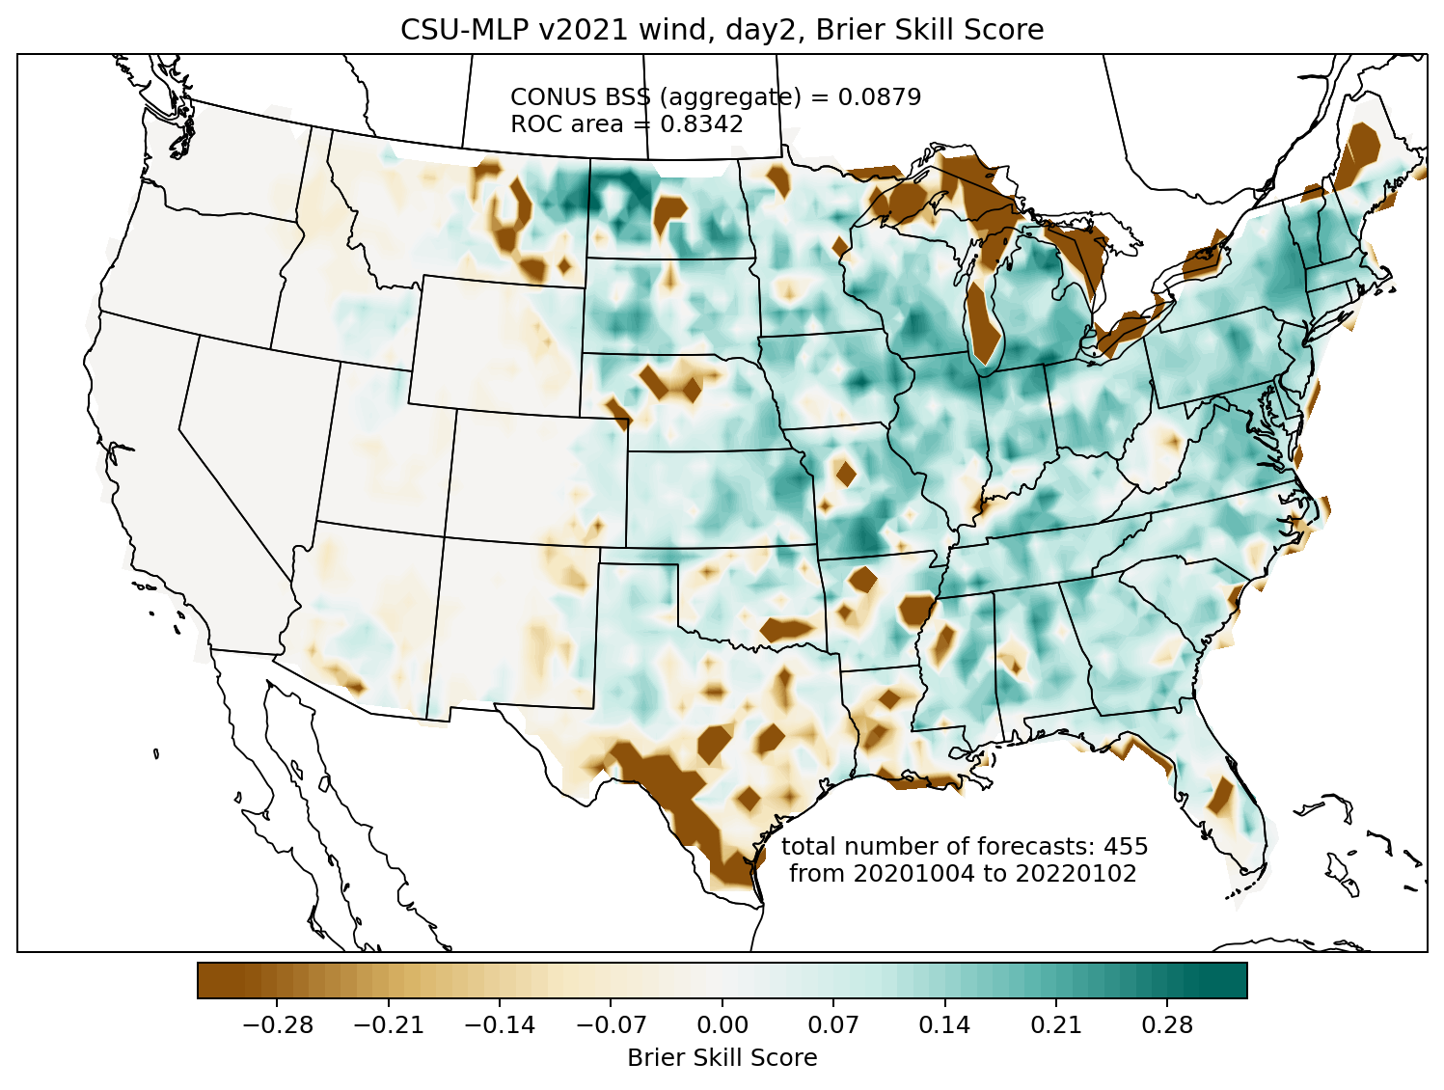
Brier skill score comparison: day 2 wind
SPC convective outlook
CSU-MLP
CSU-MLP showed higher skill, especially in the Great Lakes and northeast

Slide 13
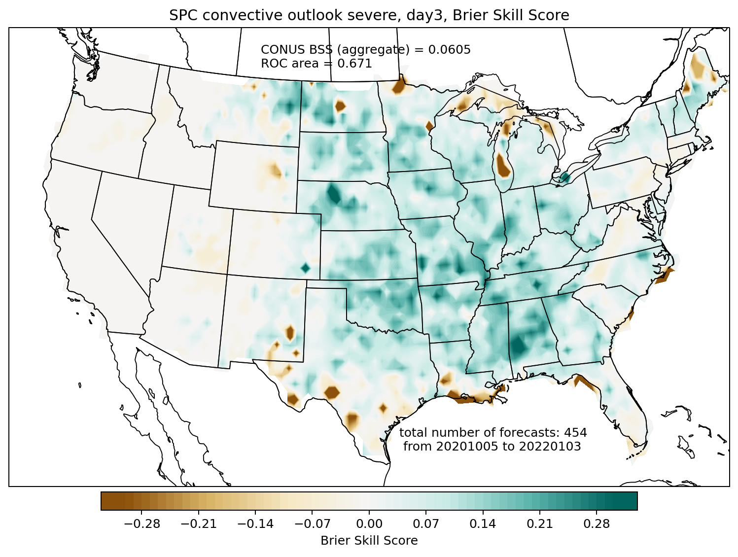
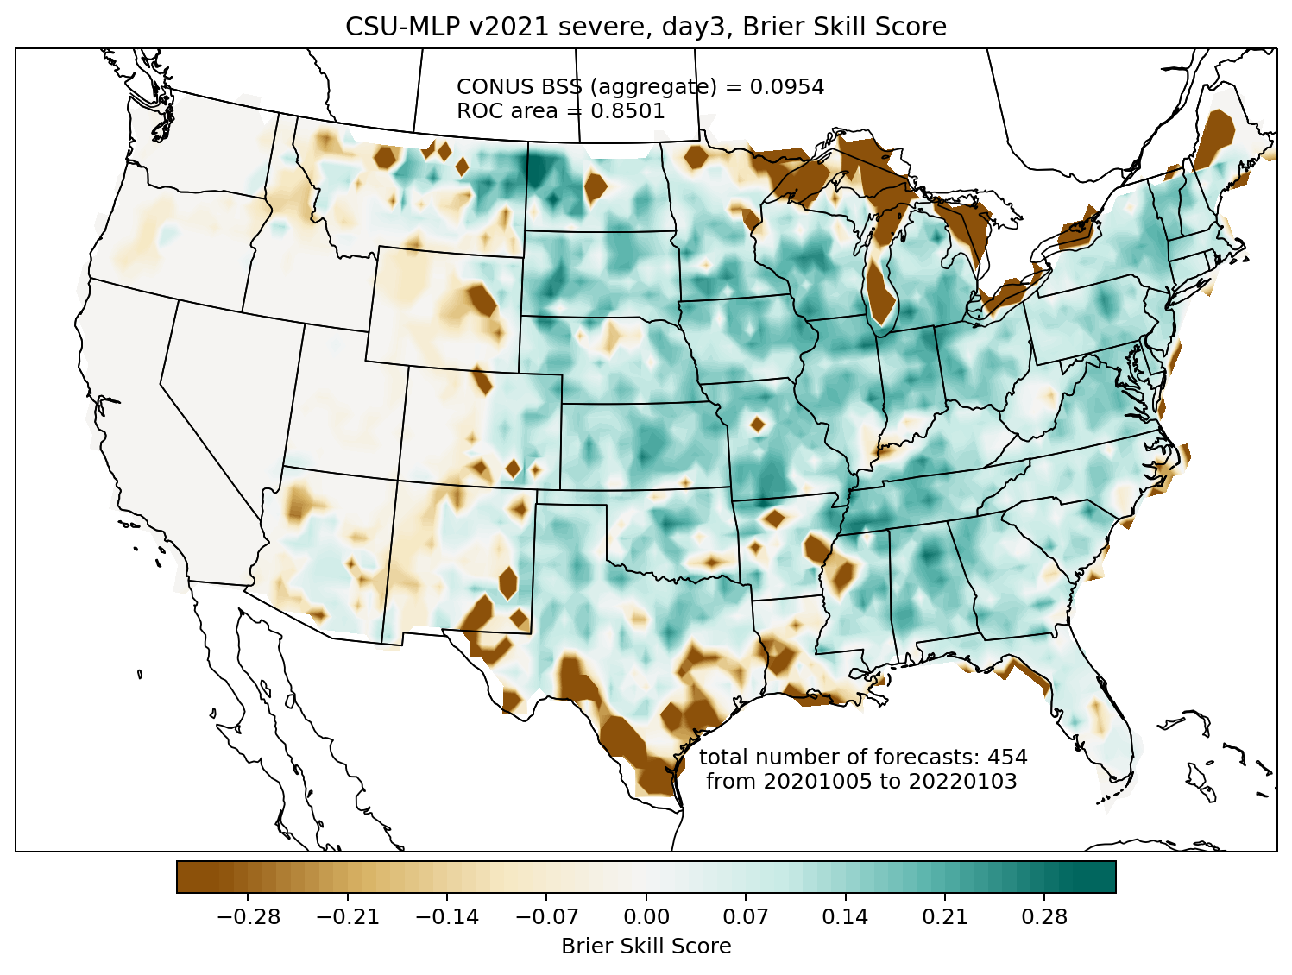
Brier skill score comparison: day 3 severe
SPC convective outlook
CSU-MLP
CSU-MLP significantly more skillful on day 3: it takes a lot more swings, and hits some big home runs, at the expense of also some big misses

Slide 14
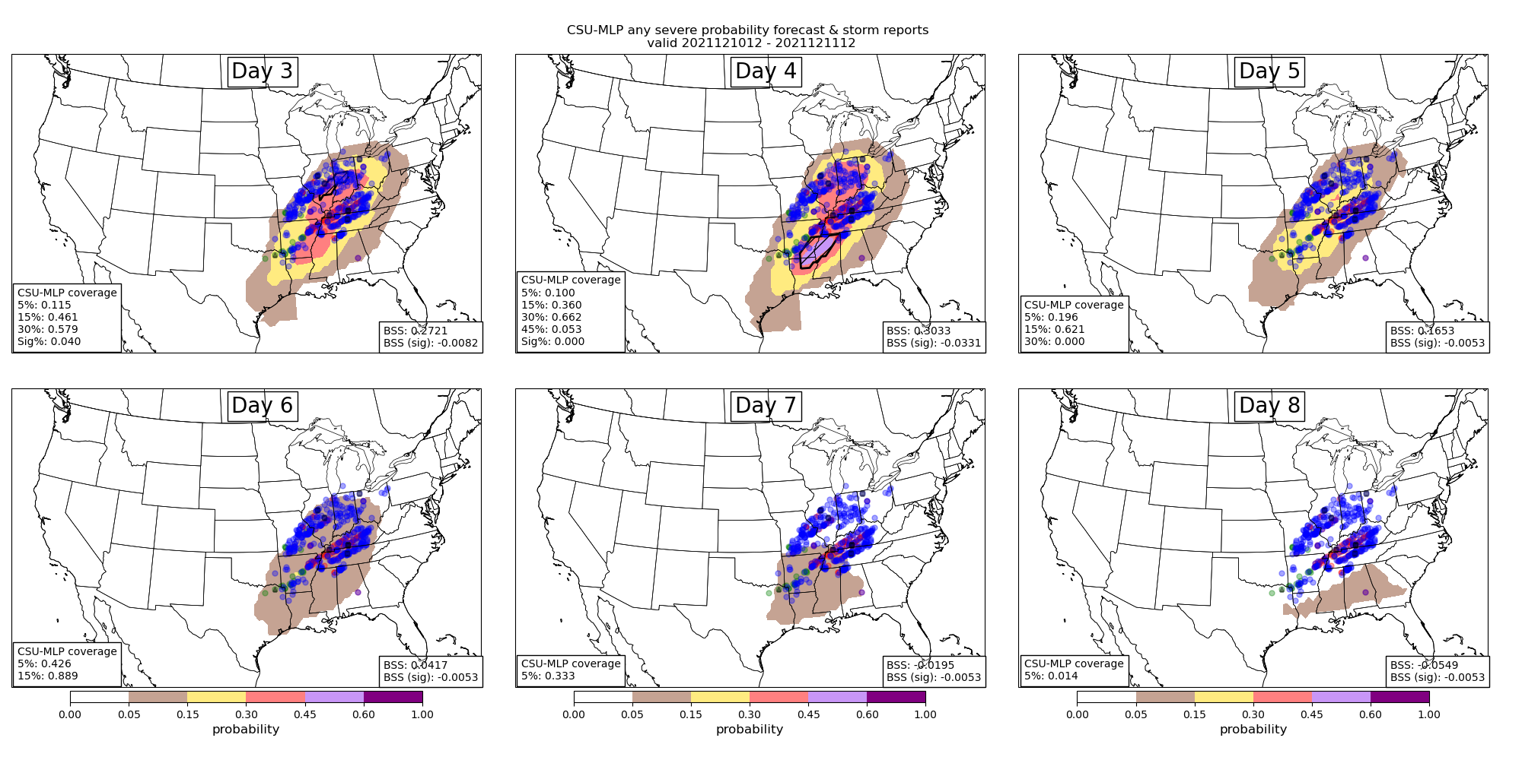
Example Forecasts
Valid 1200 – 1200 UTC 12/10/21 – 12/11/21
Hill et al. 2022, in prep

Slide 15
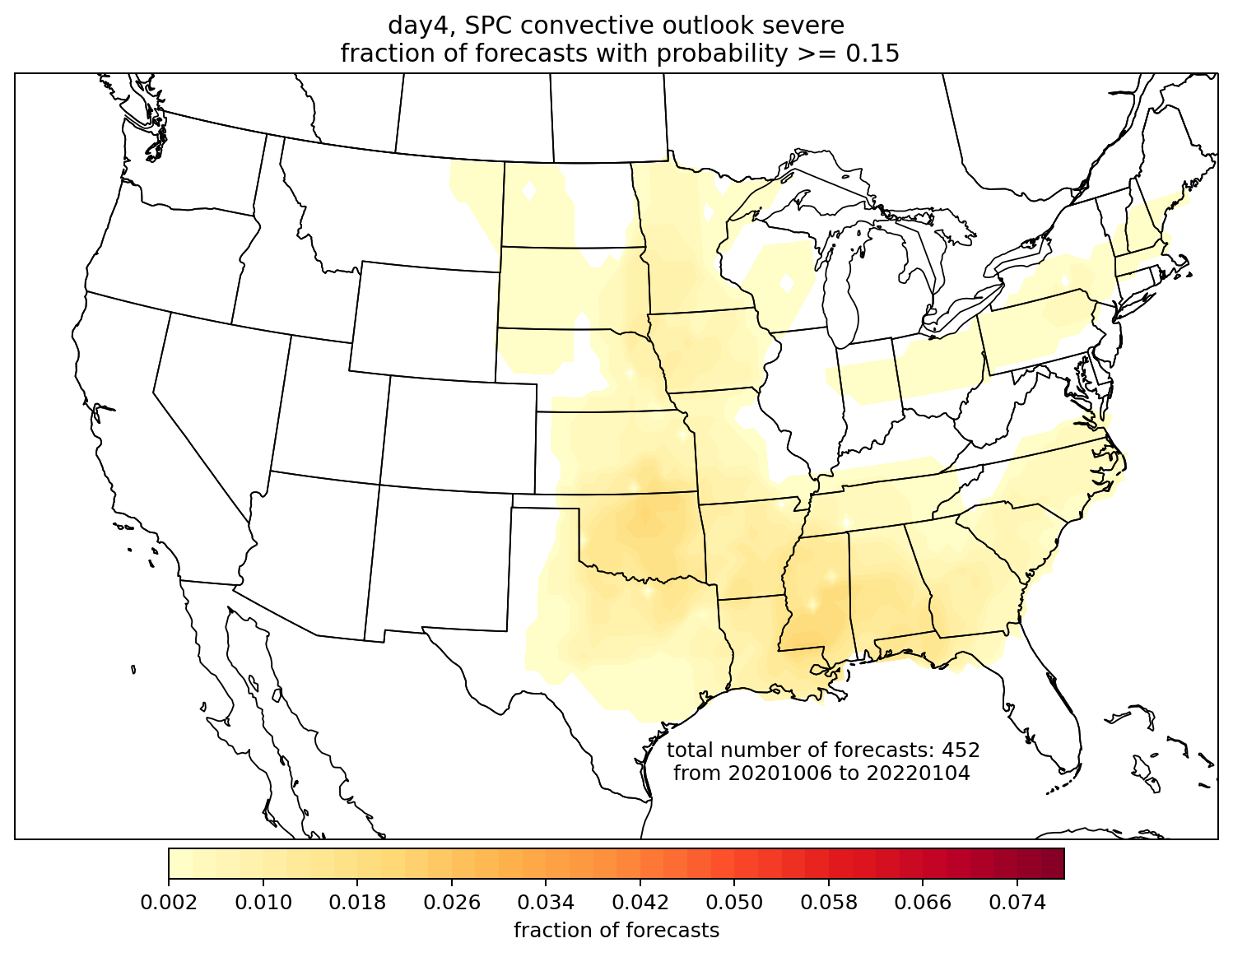
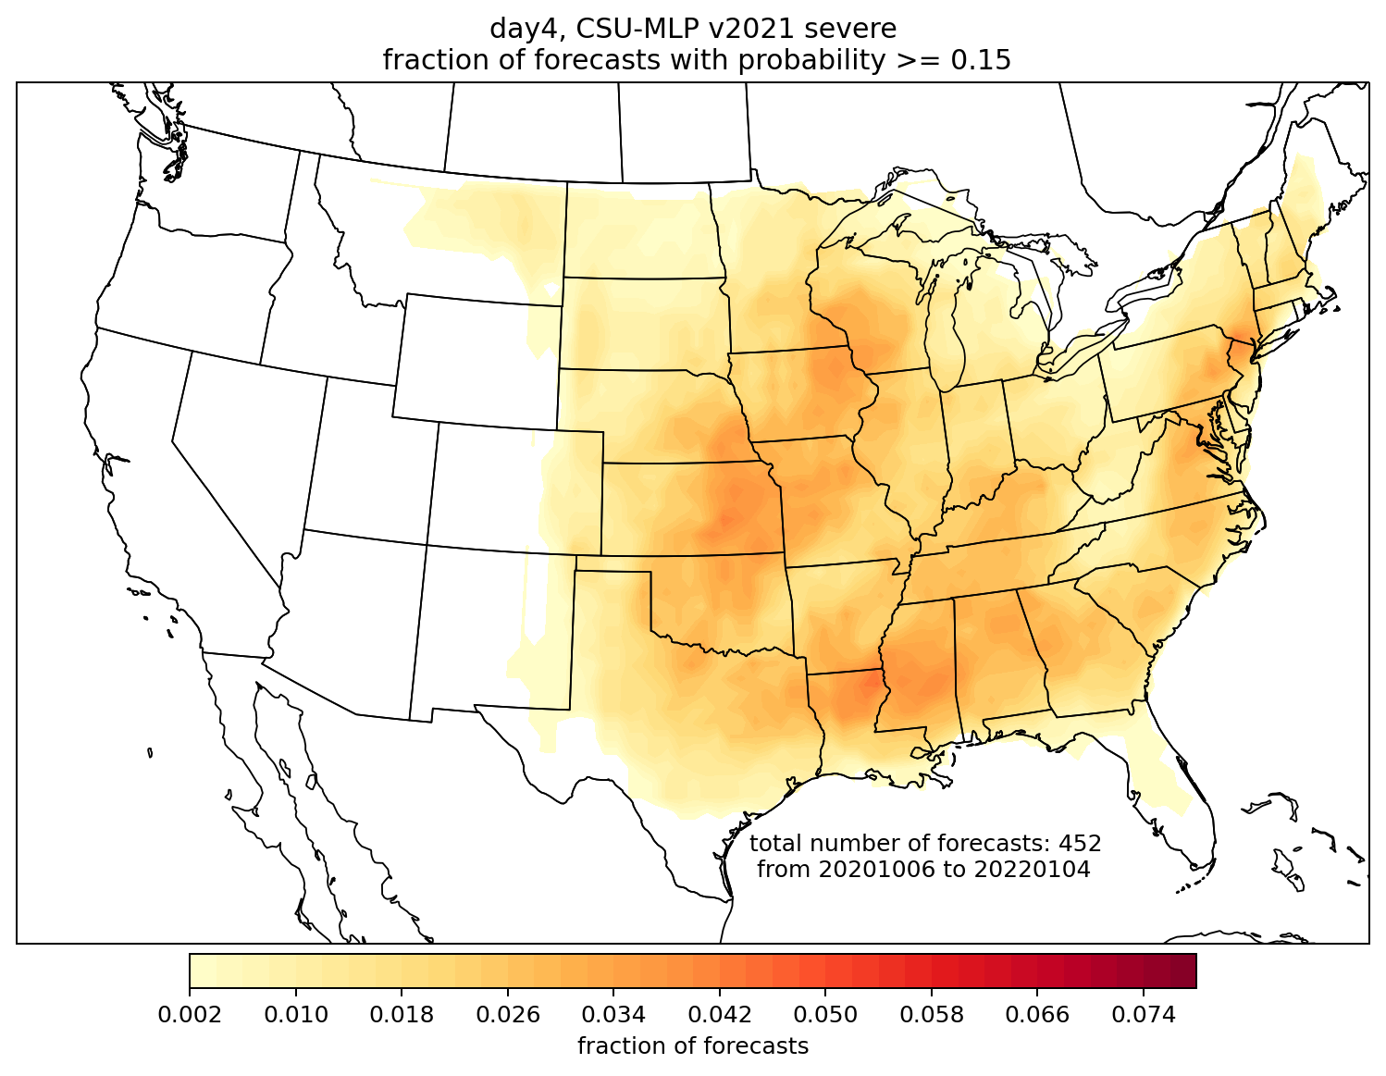
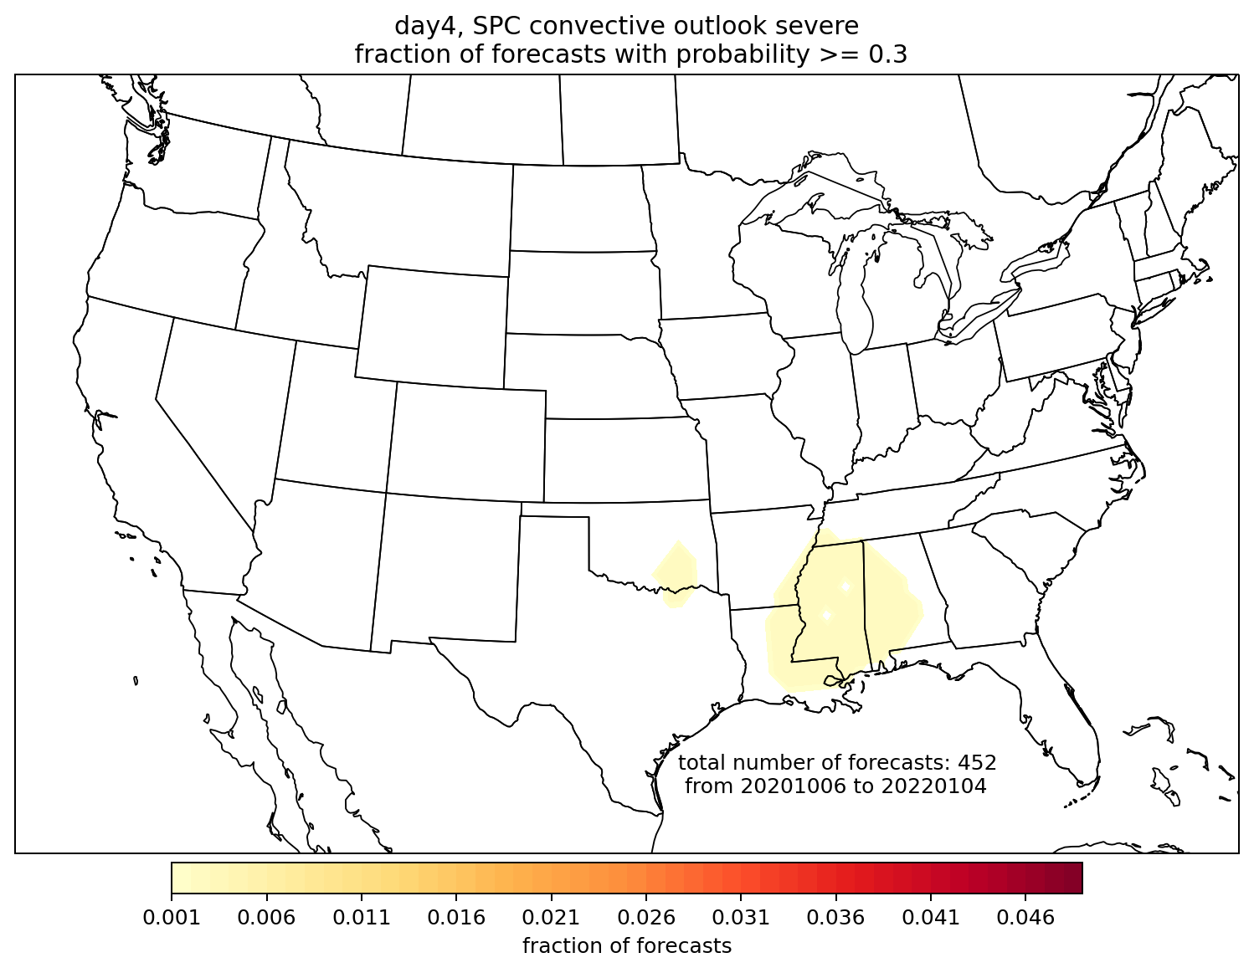
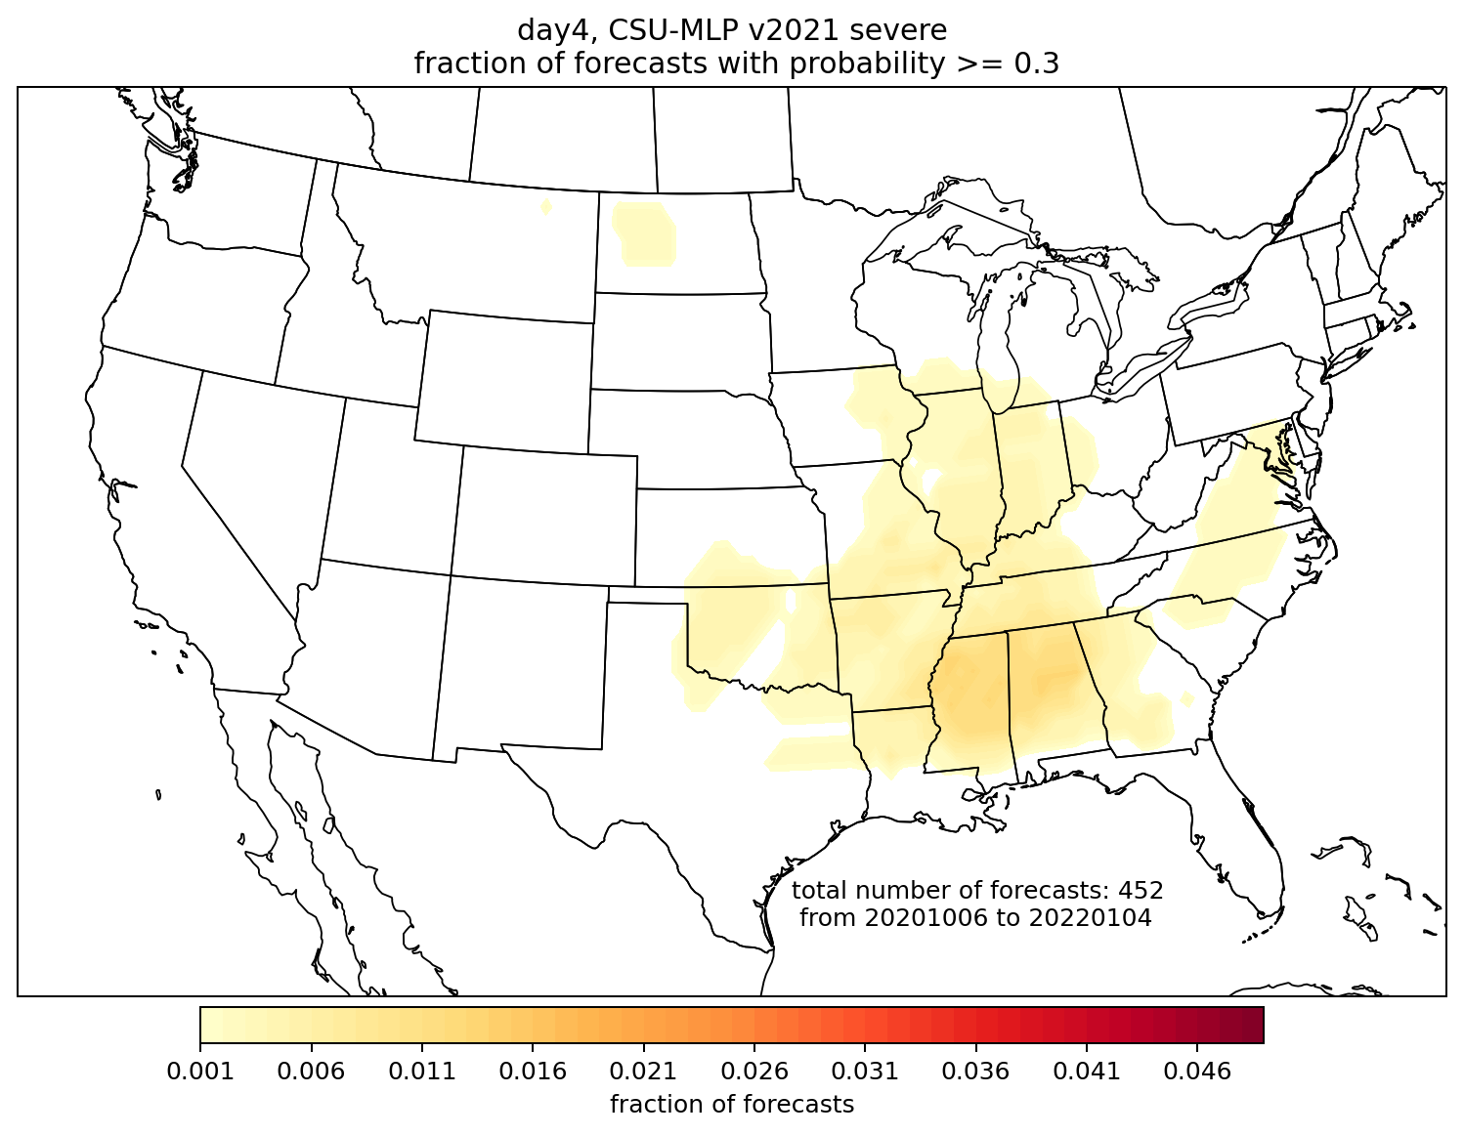
Frequency of occurrence day 4 forecasts
SPC > 15%
CSU > 15%
2 October 2020 – 31 December 2021
FV3-GEFS became operational October 2020
SPC > 30%
CSU > 30%
Hill et al. 2022, in prep

Slide 16
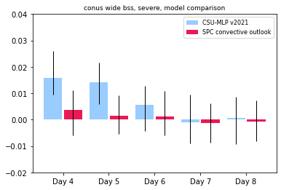
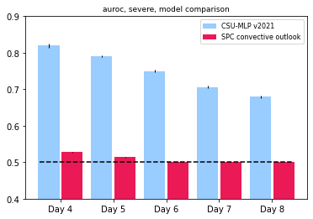
Forecast Skill
Uses 5, 15, 30, 45, and 60% contours
Day 3: 0.09
Brier Skill Score
Area under the ROC
Forecast skill extends (reasonably) out to day 6 for the CSU system
Forecast resolution (ROC area) naturally decreases with decreasing lead time; significant portion of resolution comes from low-probability contours
*Measuring SPC resolution with only two probabilistic categories is not comparable
Hill et al. 2022, in prep

Slide 17
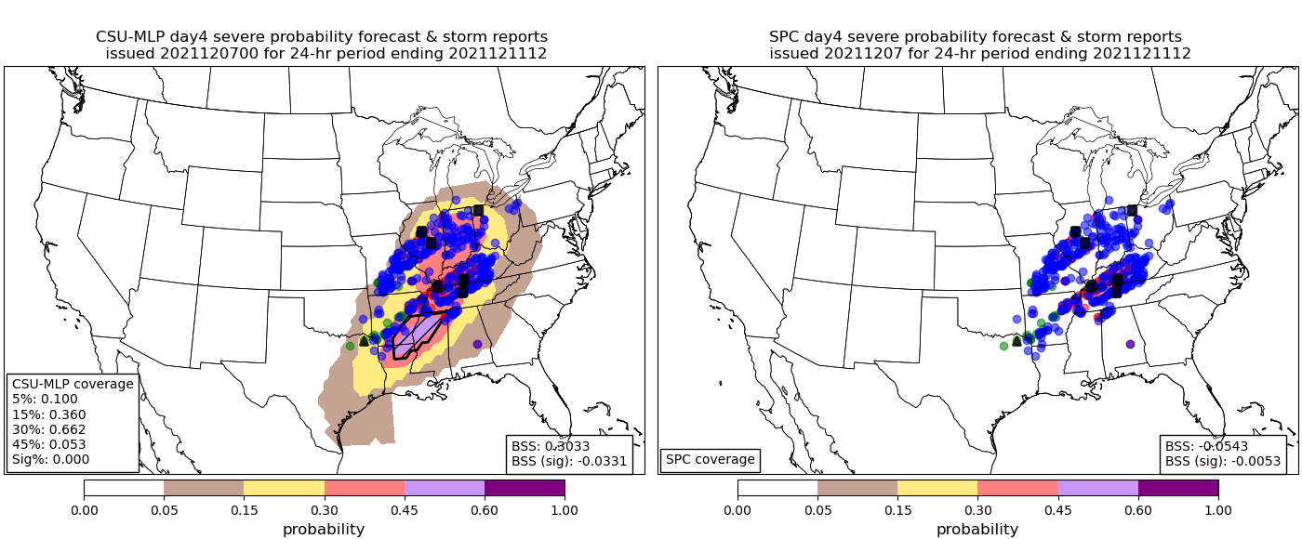
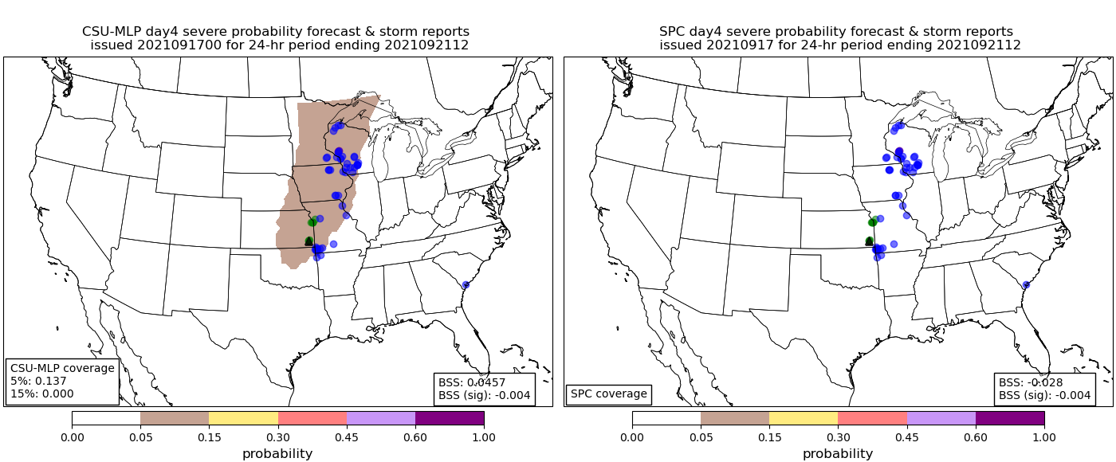
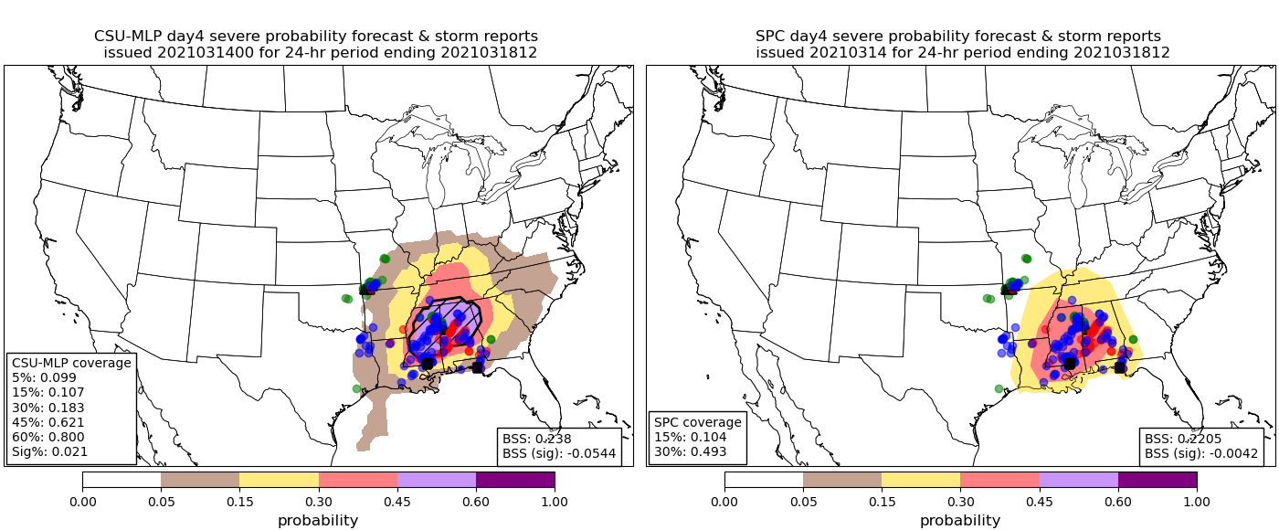
Still Learning…
Day 4
BSS: 0.303
Day 4
BSS: -0.054
BSS: 0.046
BSS: -0.028
Day 4
CSU RFs seem to benefit from frequently “swinging” at low-probability events (issuing low-probability forecasts)
But busts still occur…the “why” is a critical research question → interpretability metrics
BSS: 0.238
BSS: 0.221

Slide 18
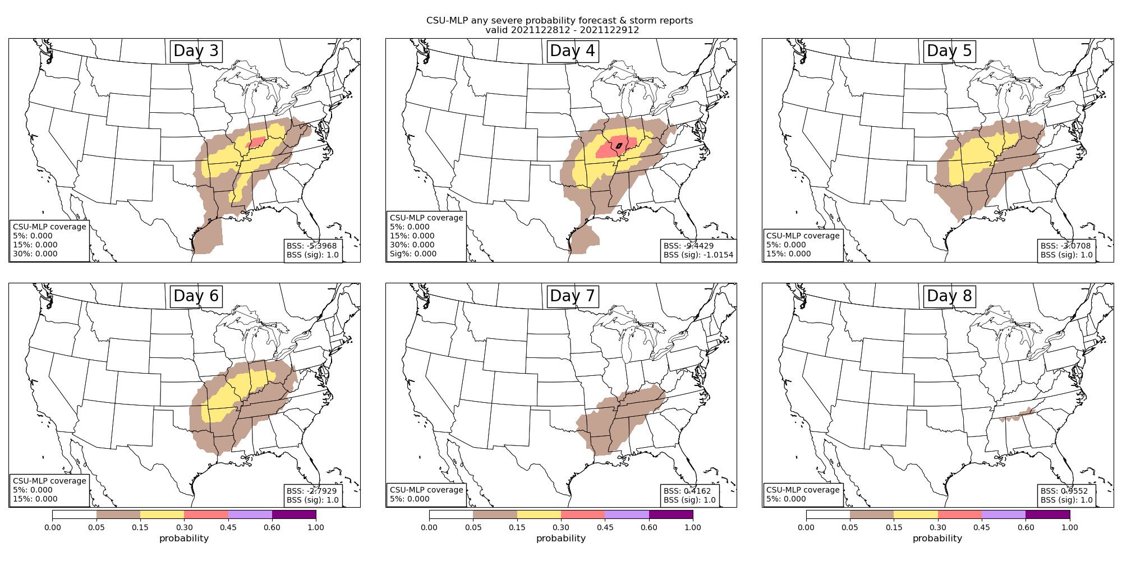
Still Learning…

Slide 19
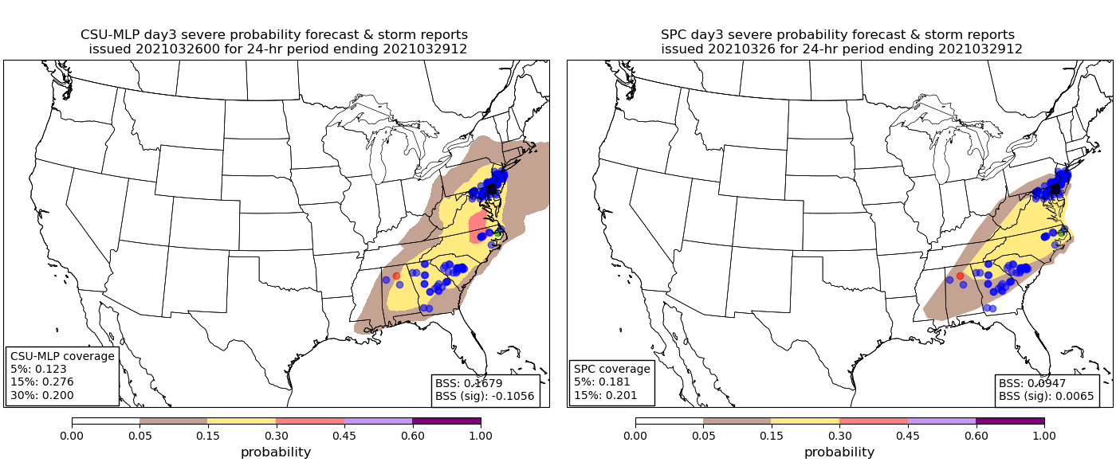
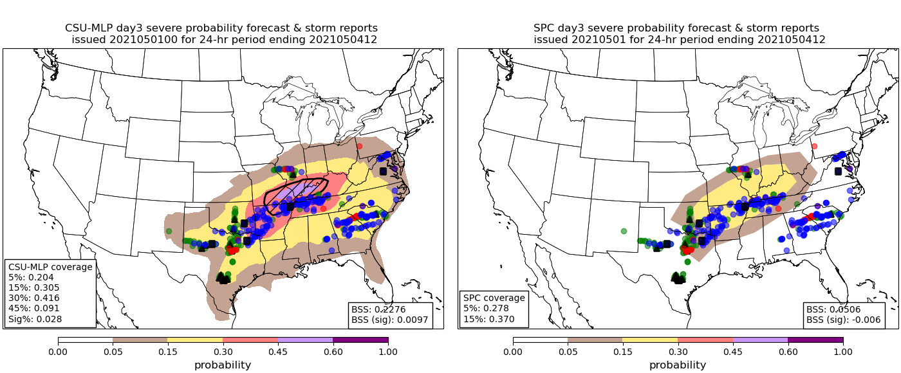
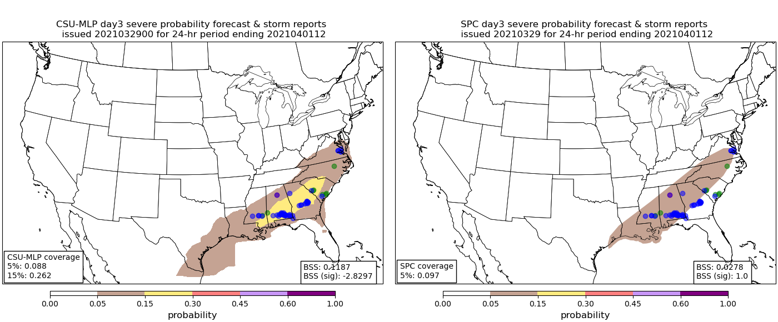
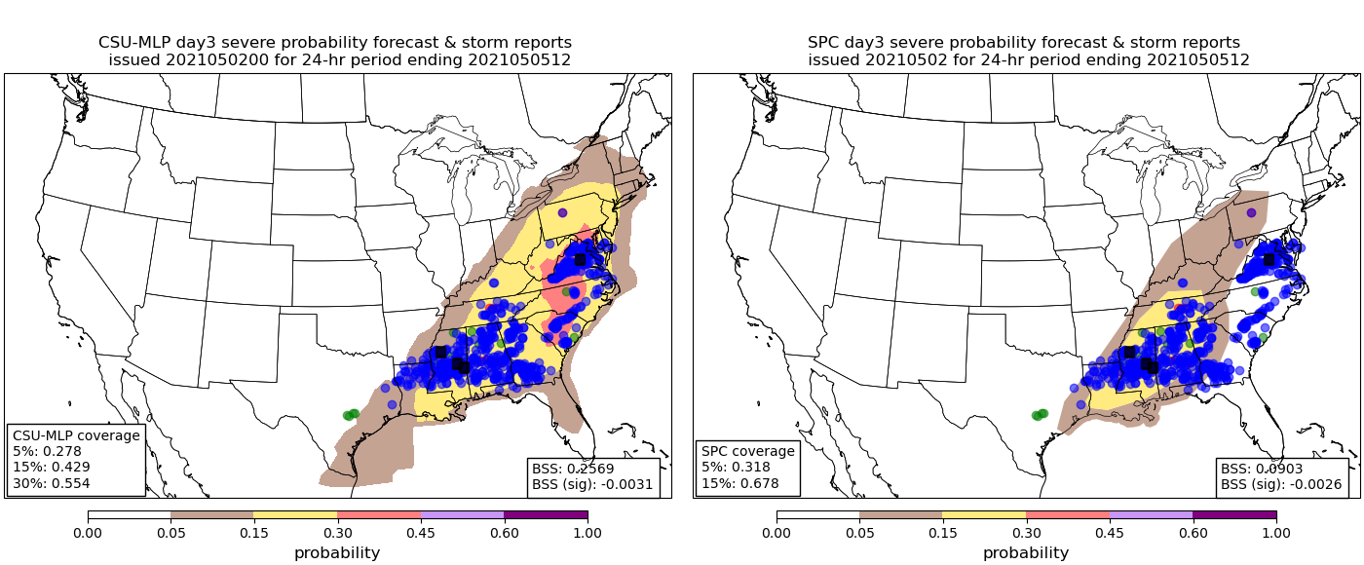
CAE Area Examples
CSU-MLP
SPC
CSU-MLP
SPC

Slide 20
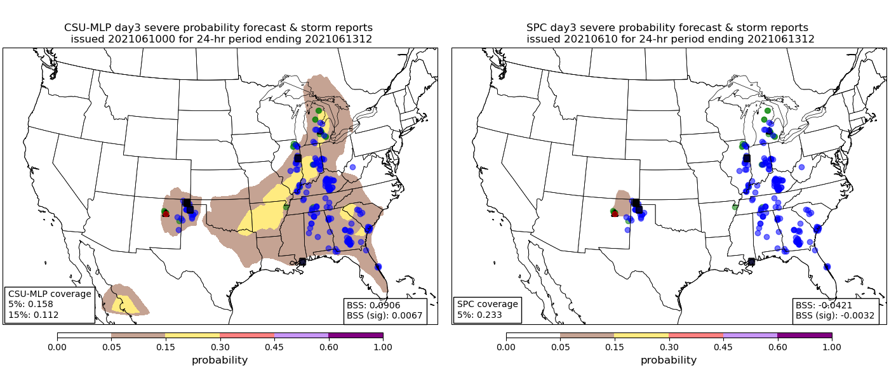
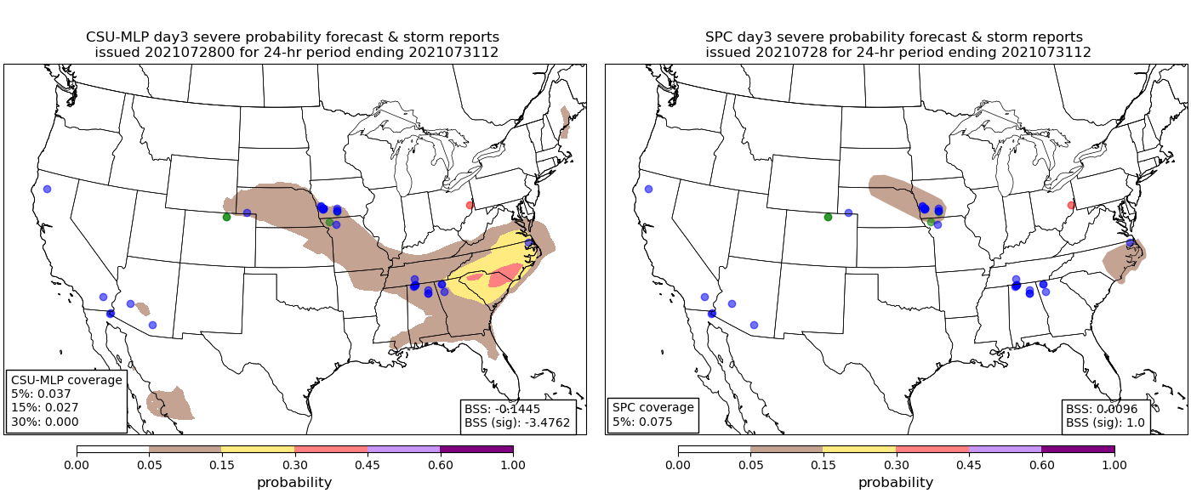
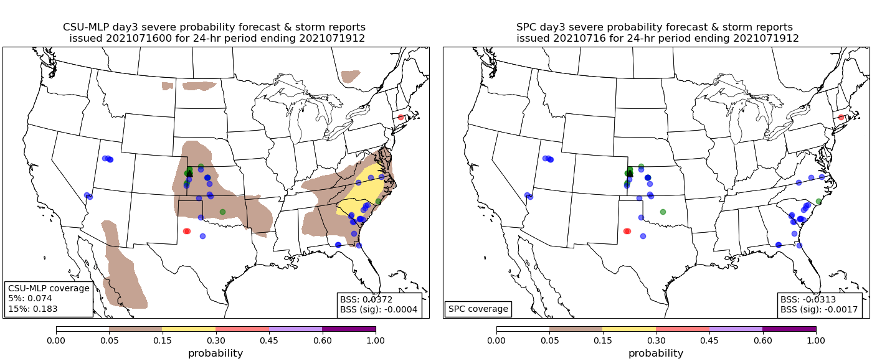
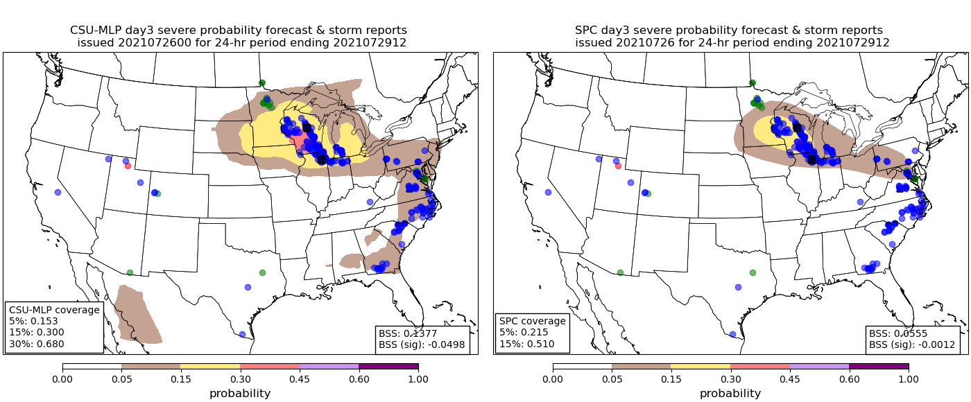
CAE Area Examples
CSU-MLP
SPC
CSU-MLP
SPC

Slide 21
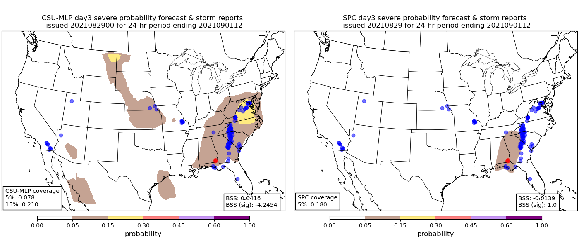
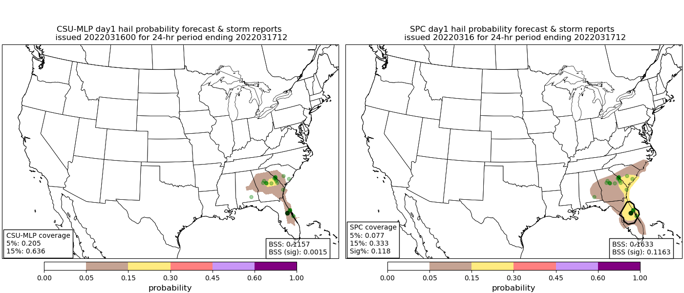
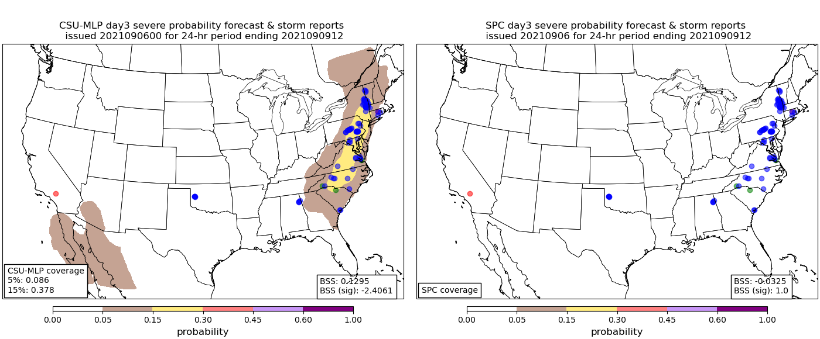
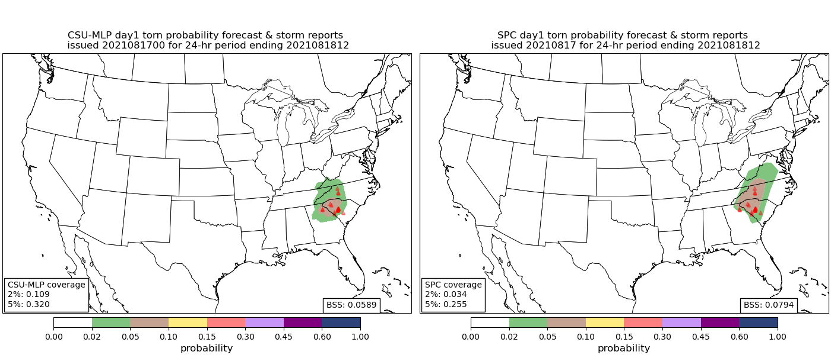
CAE Area Examples
CSU-MLP
SPC
CSU-MLP
SPC

Slide 22
Summary and Next Steps
Day 1 forecasts compare similarly to SPC outlooks; skill gap (i.e., ML better) increases at day 2 and significantly at day 3
Reasonable RF-forecast skill and resolution out to day 6, likely a result of more frequent issuances of low-probability contours
CSU-MLP issues far more frequent probability contours; SPC is conservative when issuing outlooks, but tends to correctly forecast events when outlooks are issued
What do the models rely on to make their forecasts? Interpretability
How can we leverage day-prior forecast information to inform the RFs?
Constant feedback and discussion with SPC (and NWS offices!!) to tailor products to their needs, e.g., day 9 and 10 forecasts, day 3 individual hazards
Contact: Aaron Hill (aaron.hill@colostate.edu)
Russ Schumacher (russ.schumacher@colostate.edu)

Slide 23
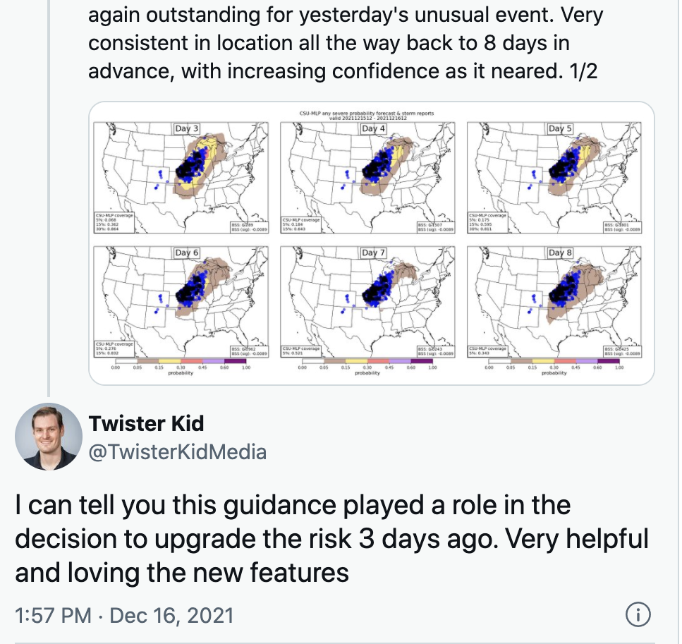
Summary and Next Steps
Day 1 forecasts compare similarly to SPC outlooks; skill gap (i.e., ML better) increases at day 2 and significantly at day 3
Reasonable RF-forecast skill and resolution out to day 6, likely a result of more frequent issuances of low-probability contours
CSU-MLP issues far more frequent probability contours; SPC is conservative when issuing outlooks, but tends to correctly forecast events when outlooks are issued
What do the models rely on to make their forecasts? Interpretability
How can we leverage day-prior forecast information to inform the RFs?
Constant feedback and discussion with SPC (and NWS offices!!) to tailor products to their needs, e.g., day 9 and 10 forecasts, day 3 individual hazards
Andrew Lyons, SPC Forecaster
Contact: Aaron Hill (aaron.hill@colostate.edu)
Russ Schumacher (russ.schumacher@colostate.edu)

Slide 24
Summary and Next Steps
Day 1 forecasts compare similarly to SPC outlooks; skill gap (i.e., ML better) increases at day 2 and significantly at day 3
Reasonable RF-forecast skill and resolution out to day 6, likely a result of more frequent issuances of low-probability contours
CSU-MLP issues far more frequent probability contours; SPC is conservative when issuing outlooks, but tends to correctly forecast events when outlooks are issued
What do the models rely on to make their forecasts? Interpretability
How can we leverage day-prior forecast information to inform the RFs?
Constant feedback and discussion with SPC (and NWS offices!!) to tailor products to their needs, e.g., day 9 and 10 forecasts, day 3 individual hazards
Contact: Aaron Hill (aaron.hill@colostate.edu)
Russ Schumacher (russ.schumacher@colostate.edu)

